Slide 1
Class 10- Dictionary
Intro to dictionary and its related operations

Slide 2
Introduction to Dictionary
Python offers many different ways to organise collections of data items, such as strings, lists, dictionary, tuple, etc.
Dictionaries are mutable, unordered collections with elements in the form of a key:value pairs that associate keys to values.
Internally dictionary are indexed on the basis keys.
Dictionary are also called associative arrays or mappings or hashes.

Slide 3
Creating Dictionary
Empty dictionary :
l = dict() or l = {}
Single Element dictionary:
l = {key:value}

Slide 5
Accessing Elements in a dictionary

Slide 6
Accessing Individual Elements print(d[“goose”])

Slide 7
Traversing a dictionary
for loop makes it easy to traverse or loop over items in a dictionary.
for var in l:
print(l[var]) #variable equivalent
To access only the keys of the dictionary :- dictionary.keys()
To access only the values of the dictionary :- dictionary.values()

Slide 8
Characteristics of a dictionary

Slide 14
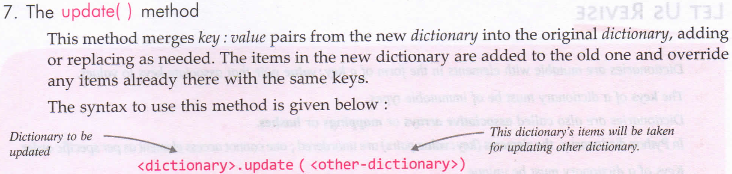
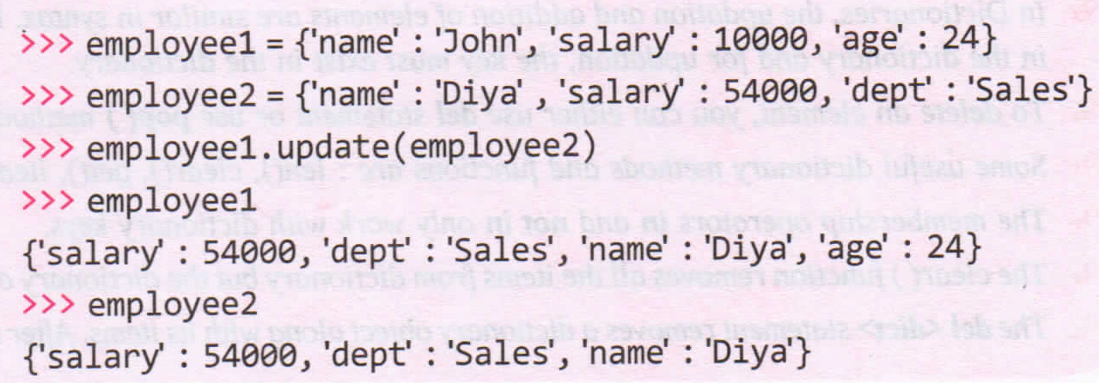

Slide 15
Multiple Ways to create dictionary

Slide 16
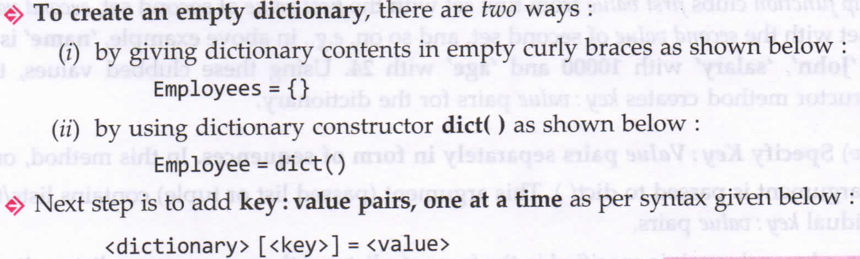
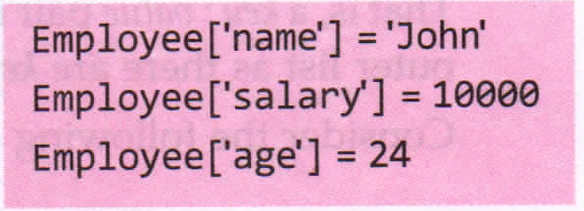

Slide 17
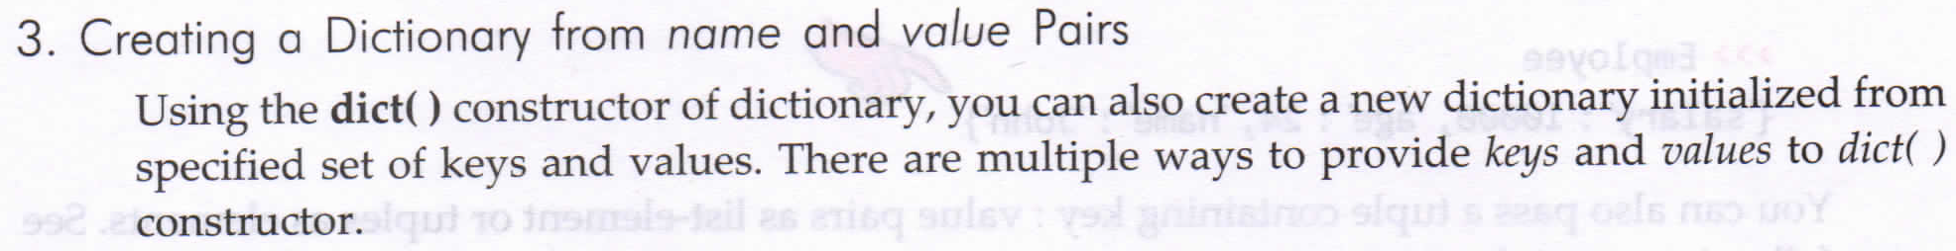
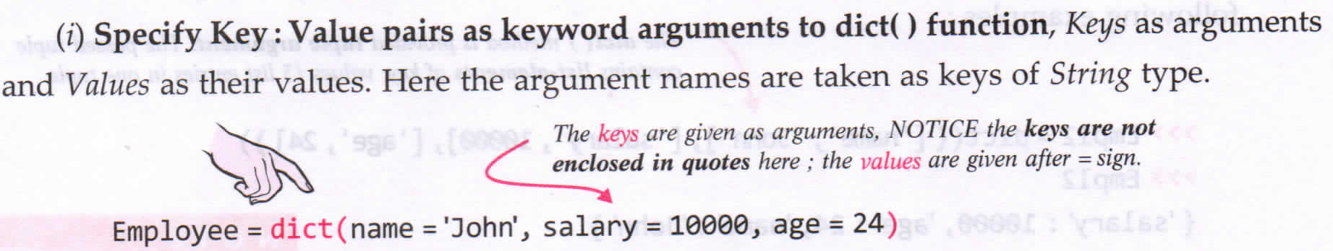

Slide 18
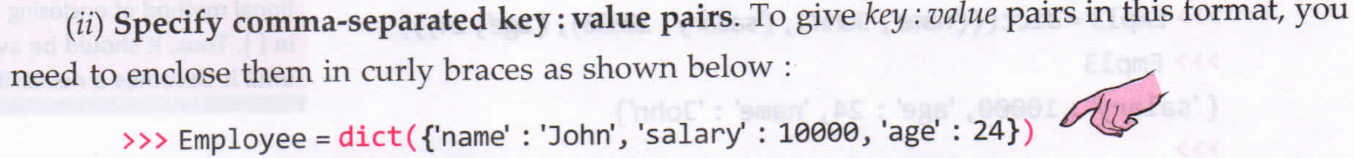
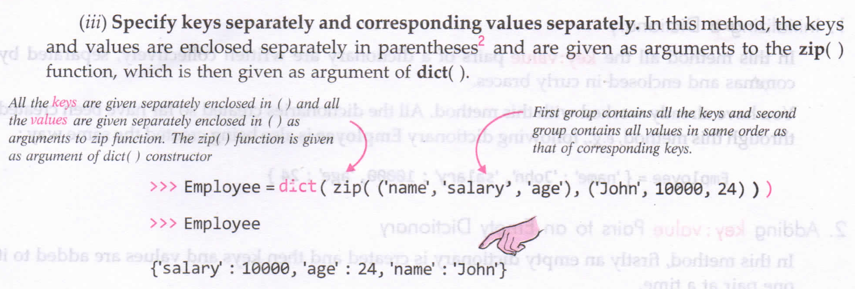

Slide 19
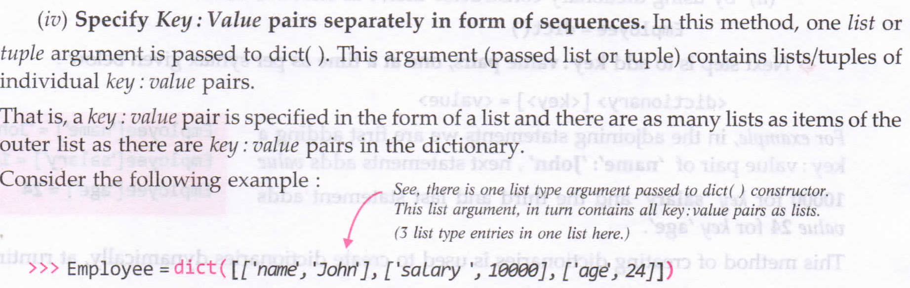

Slide 20
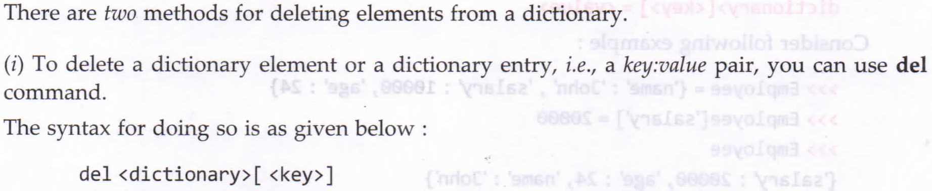
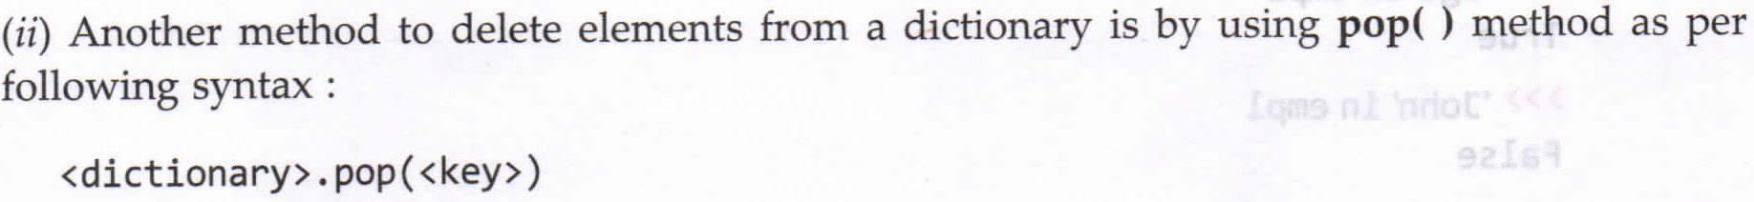
Deleting Elements in a dictionary

Slide 21
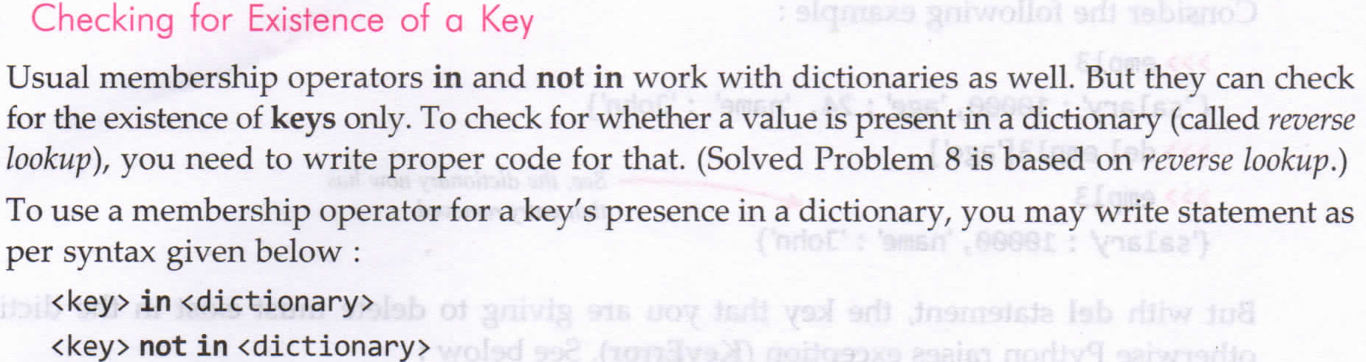
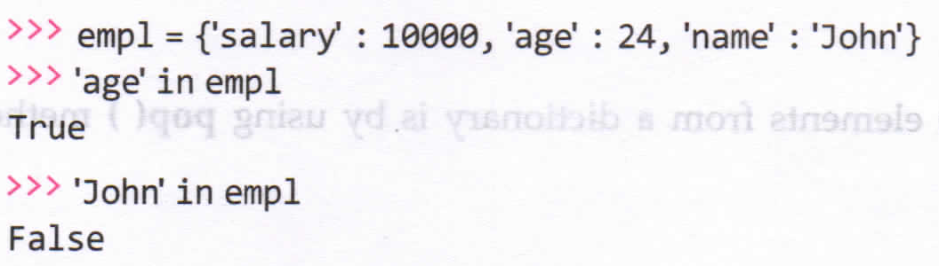

Slide 22
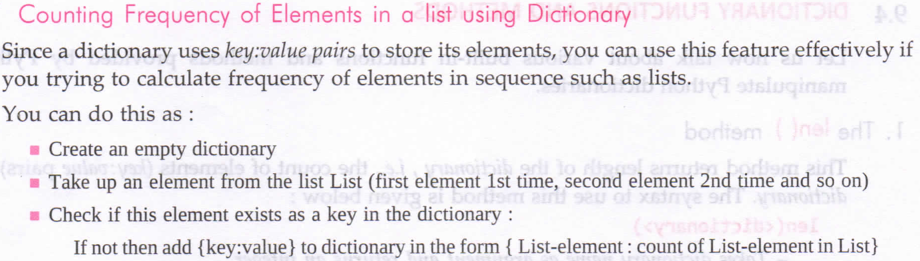
Programs
P1: Write a program to create a phone dictionary for all of your friends and then print it.(Static and Runtime Implementation)
P2: Write a python program that takes value and checks whether the given value is part of the dictionary or not. If it is, it should print the corresponding key otherwise print an error message.
# WAP to implement calculator (add,subract,divide,multiplication, modulo division). 2 numbers(int or float) ,an operator

